Slide 1
Demonstration of
Claim Registration Module screens
1) Accident screen
2) Claims screen
2.1) Own Damage selected
2.2) Property Damage/Bodily Injury selected
3) Service Provider when Insurer selected
4) Notes screen
5) Tasks Screen
6) Attachment Screen
7) Diary Screen
8) Reserve Screen
8.1) OD Reserve Request selected
8.2) PD Reserve Request Claim Selected
8.3) BI Reserve Request Claim Selected
8.4) LOG Request Selected

Slide 2
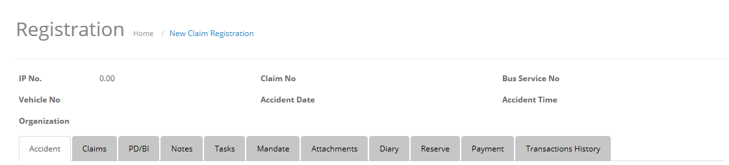
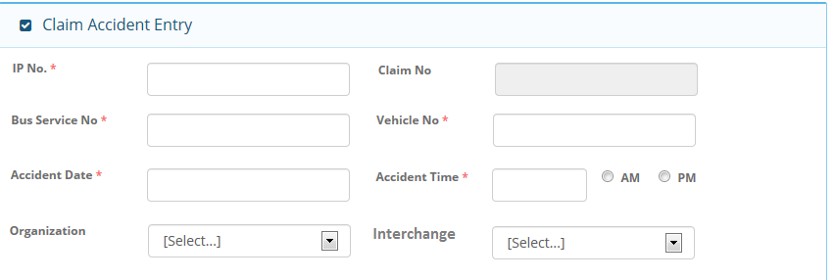
1) Accident Screen
1.1) Accident screen Header
1.2) Accident Screen -> Claim Accident Entry Section

Slide 3
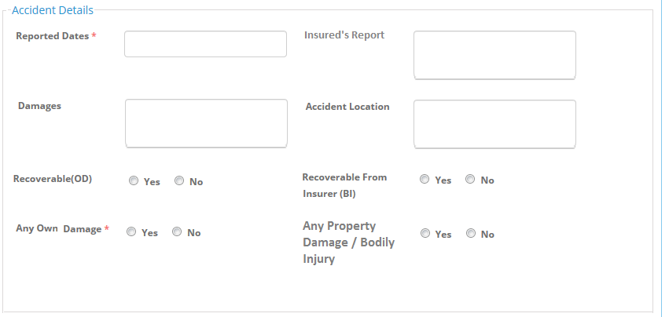
1.3) Accident Screen -> Accident Details section

Slide 4
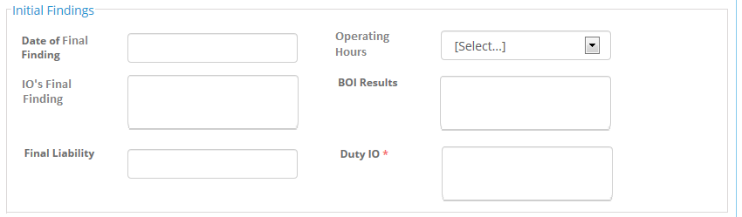
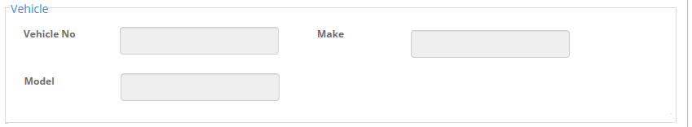
1.4) Accident Screen -> Initial Findings Section
1.5) Accident Screen -> Vehicle Section

Slide 5
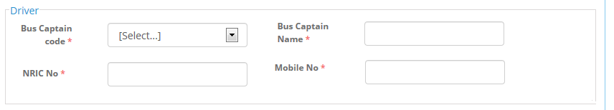
1.6) Accident Screen -> Driver Section
1.7) Accident Screen -> Footer

Slide 6
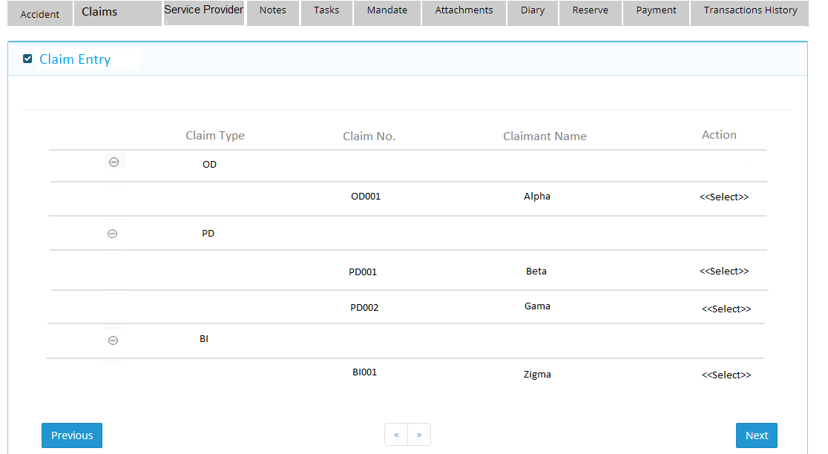
2) Claims Screen
2.1) Claims Screen when Own Damage selected
2.1.a ) Grid of Claims Screen

Slide 7
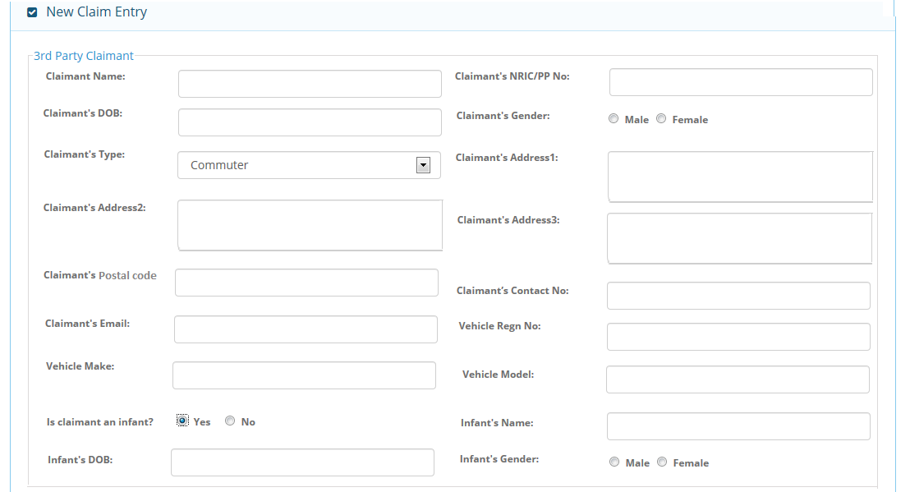
2.1.b) 3rd Party Claimant Section

Slide 8
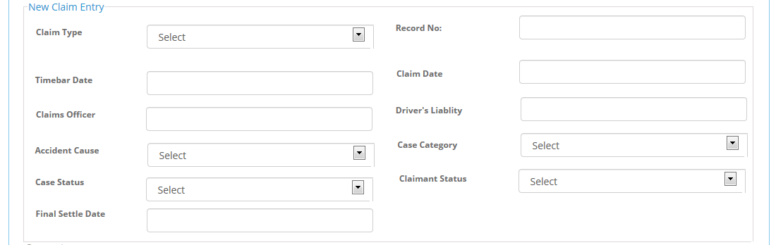
2.1.C) New Claim Entry Section

Slide 9
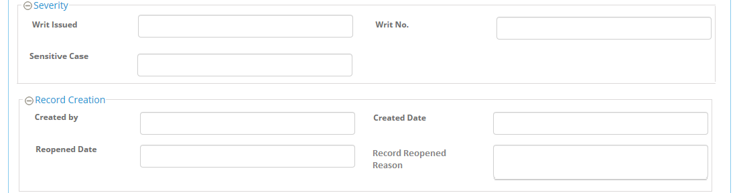
2.1.d) Severity and Record Creation Section

Slide 10
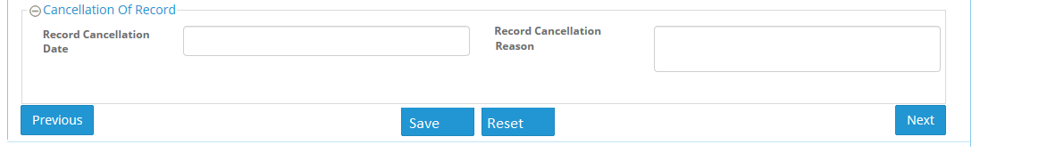
2.1.e) Cancellation of Record Section and Footer

Slide 11
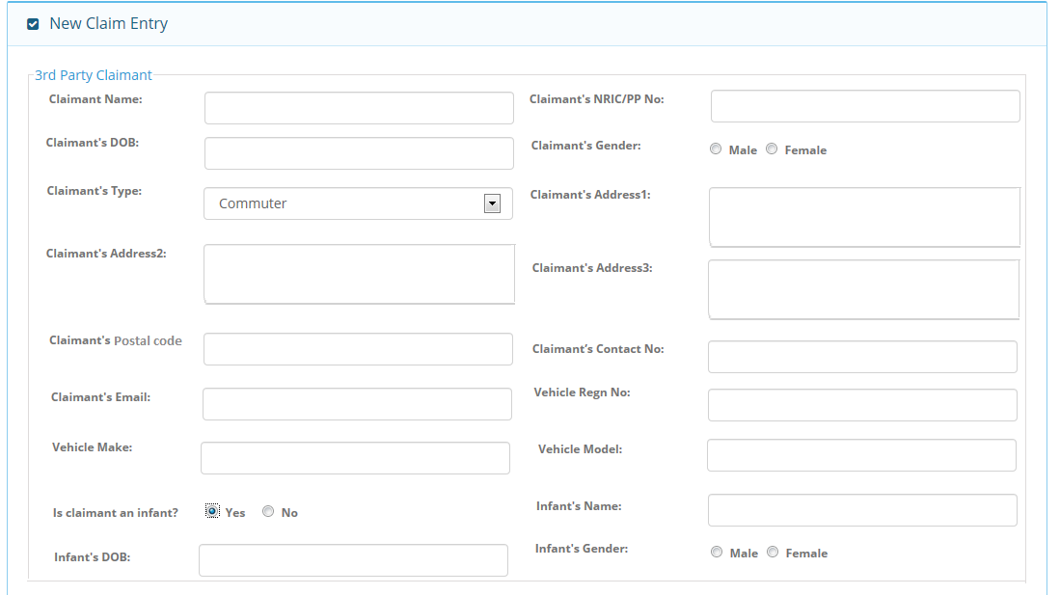
2.2) Claims Screen when Property Damage / Bodily Injury selected
2.2.a) 3rd Party Section

Slide 12
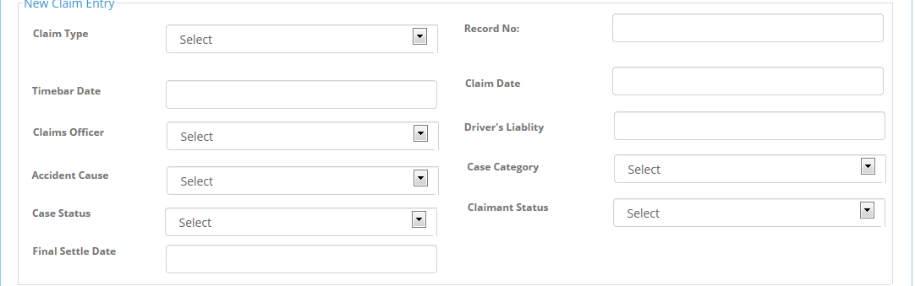
2.2.b) New Claim Entry Section

Slide 13
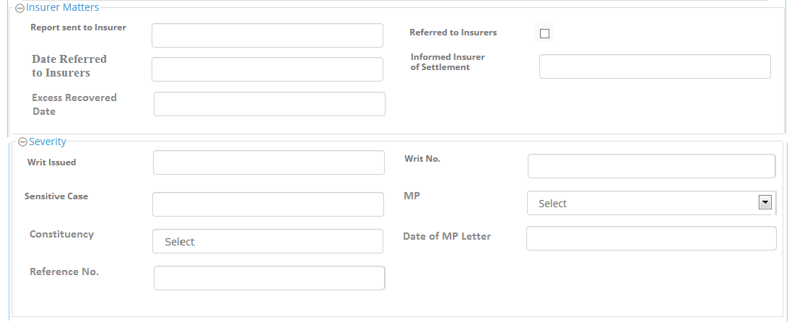
2.2.c) Insurer Matters and Severity Section

Slide 14
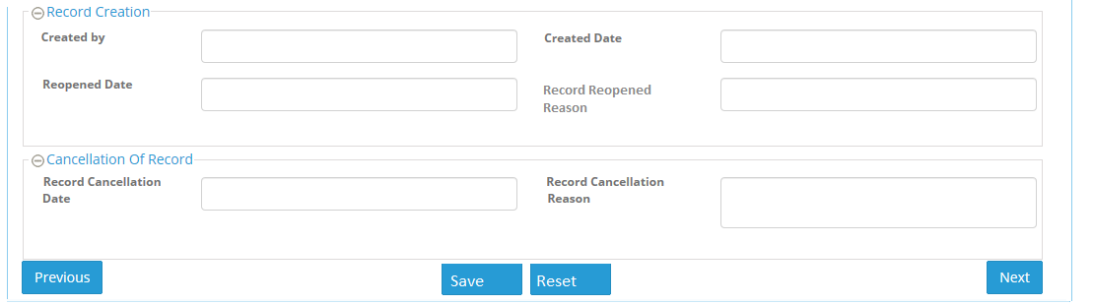
2.2.d) Record Creation and Cancellation of Record Section

Slide 15
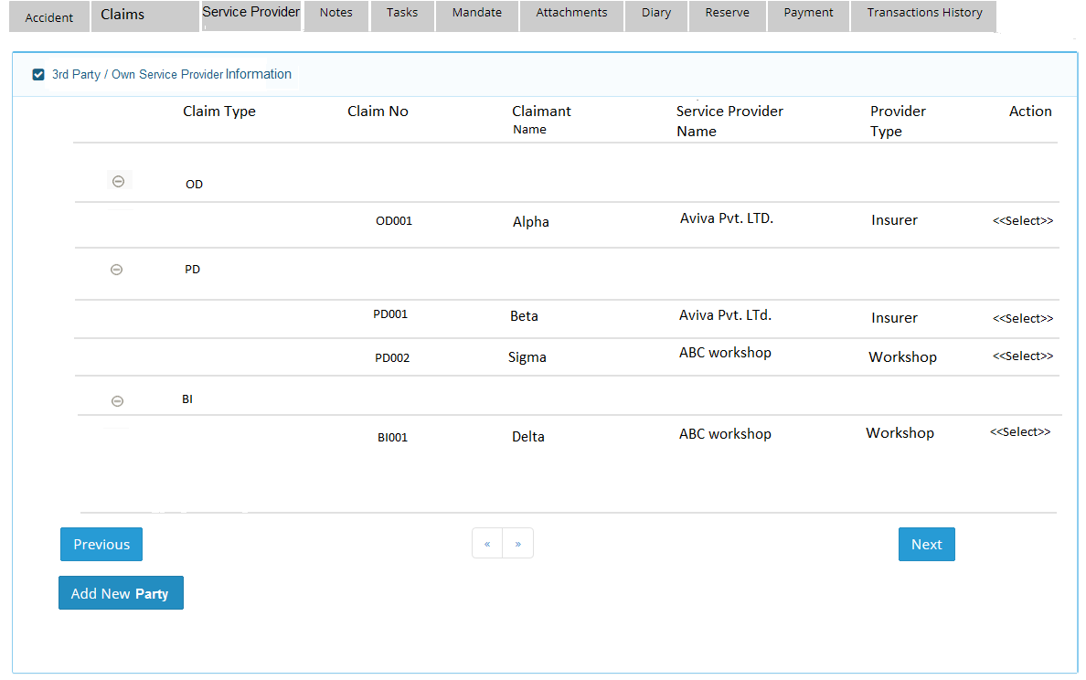
3) Service Provider Screen
3.1) Grid section

Slide 16
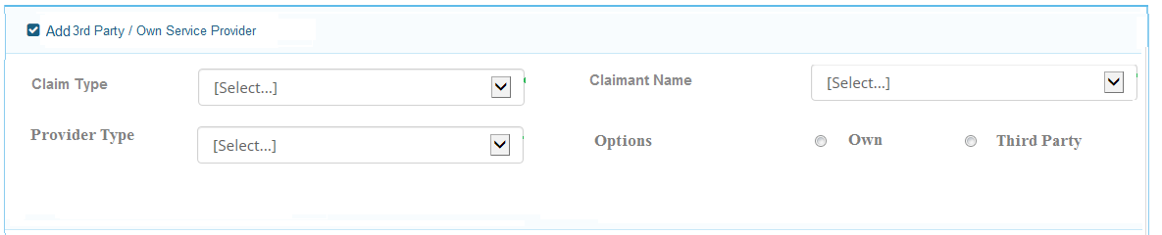
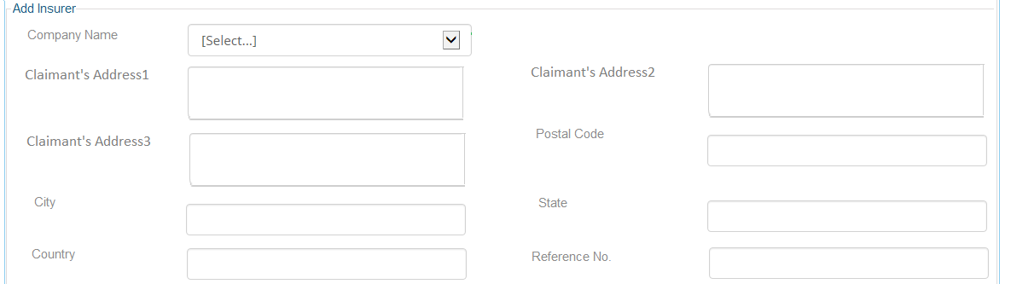
3.2) Add 3rd Party / Own Service Provider section(Input Criteria for Service provider )
3.3) Add Insurer Section (Partial Part)

Slide 17
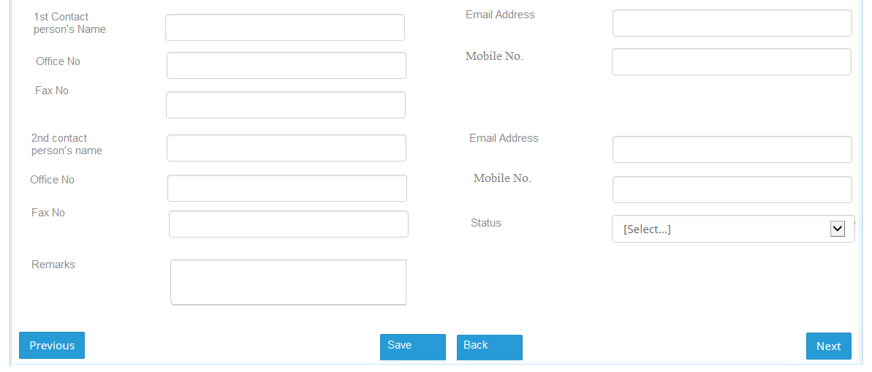
3.3) Add Insurer Section ( Remaining Part)

Slide 18
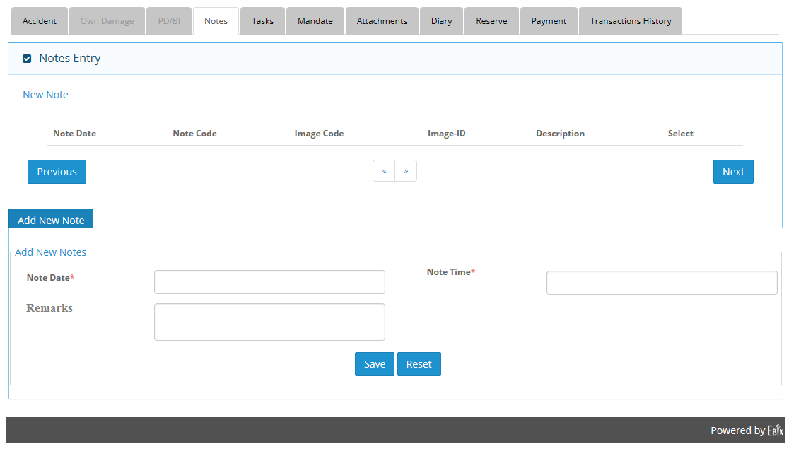
4) Notes Screen
4.1) Grid and Add Section

Slide 19
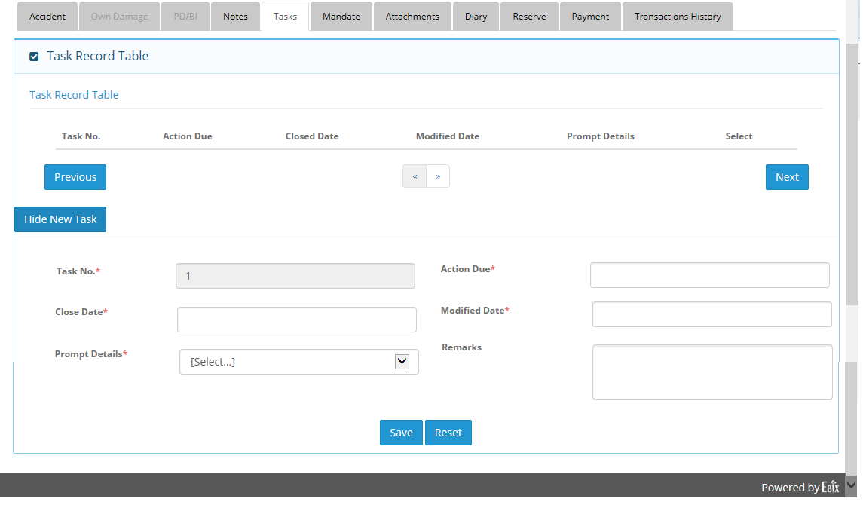
5) Tasks Screen
5.1) Grid and Add Section

Slide 20
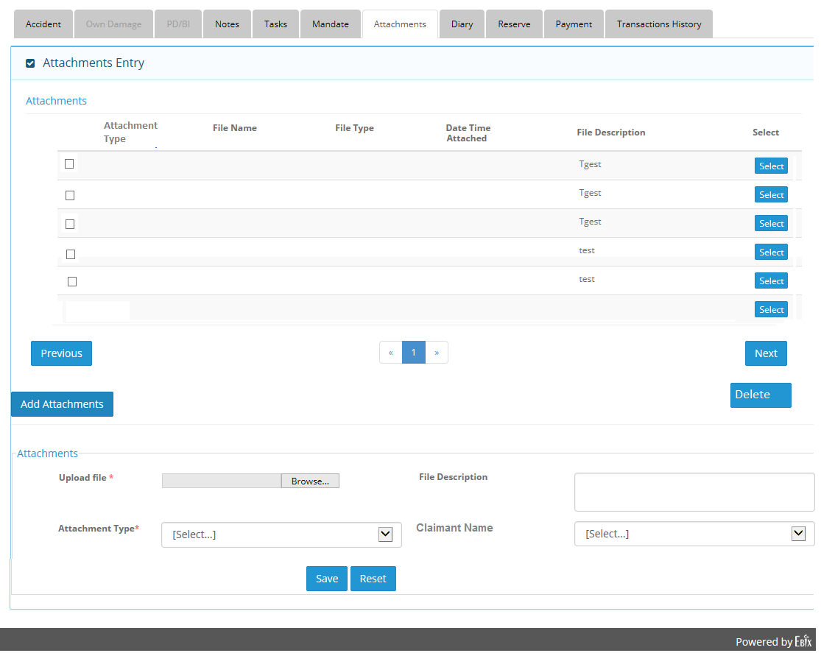
6) Attachment Screen
6.1) Grid and Add Section

Slide 21
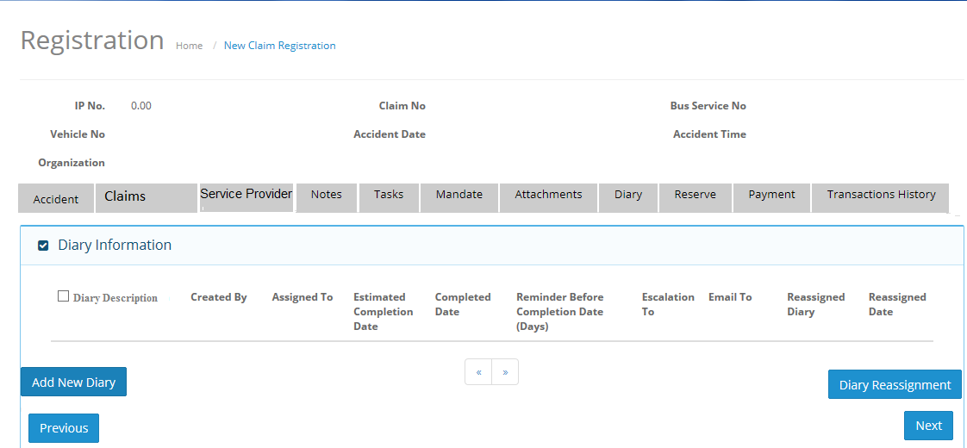
7) Diary Screen
7.1) Header and Grid Section

Slide 22
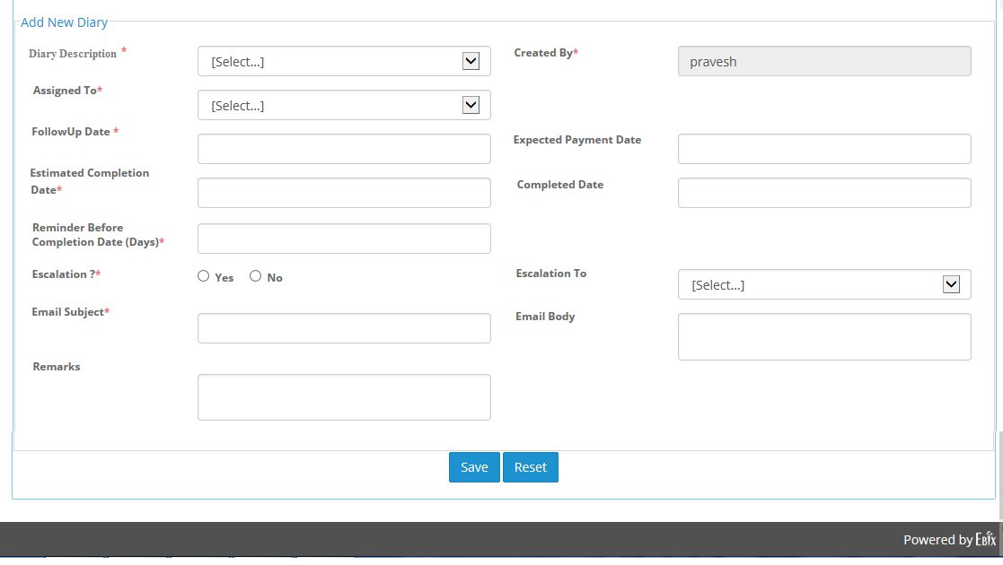
7.2) Add New Diary Screen

Slide 23
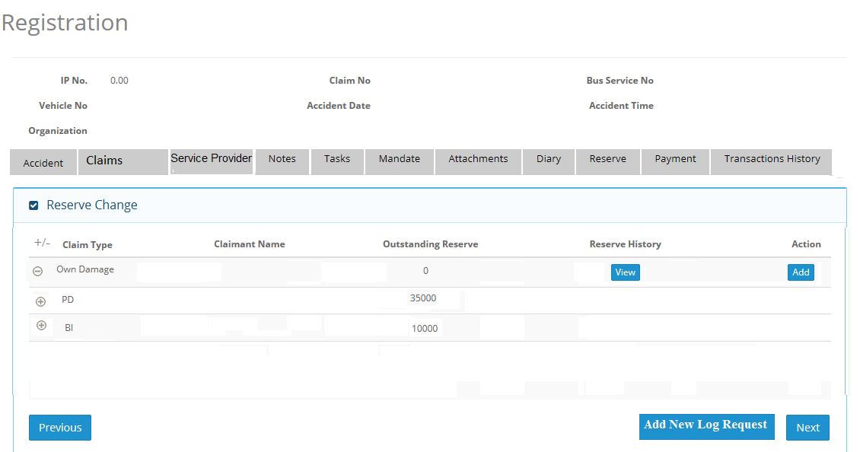
8) Reserve Screen
8.1) Own Damage Reserve Request
8.1.a) Header and Grid Section

Slide 24
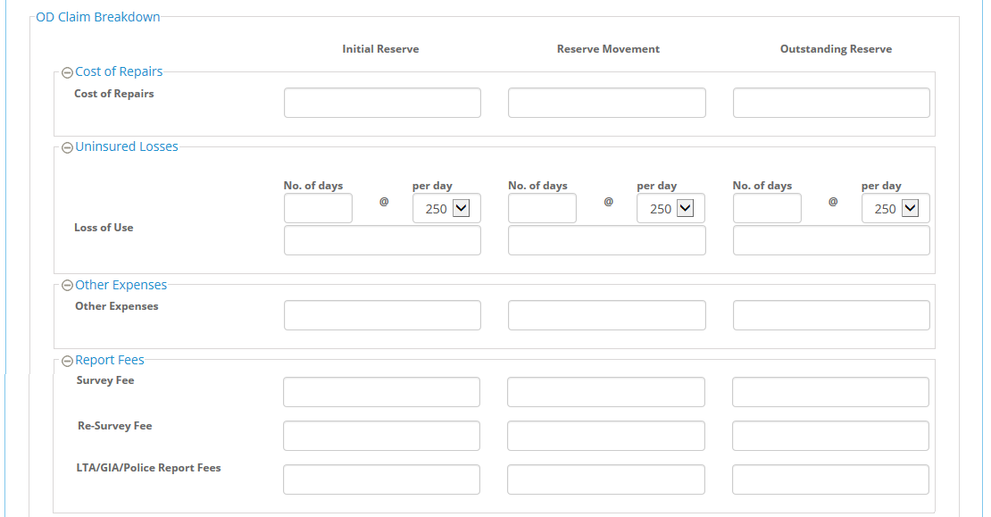
8.1.b) OD Claim Reserve Request sections ( Partial Part )
a) Cost of Repairs,b) Uninsured Losses, c) Other Expenses, d) Report Fees

Slide 25
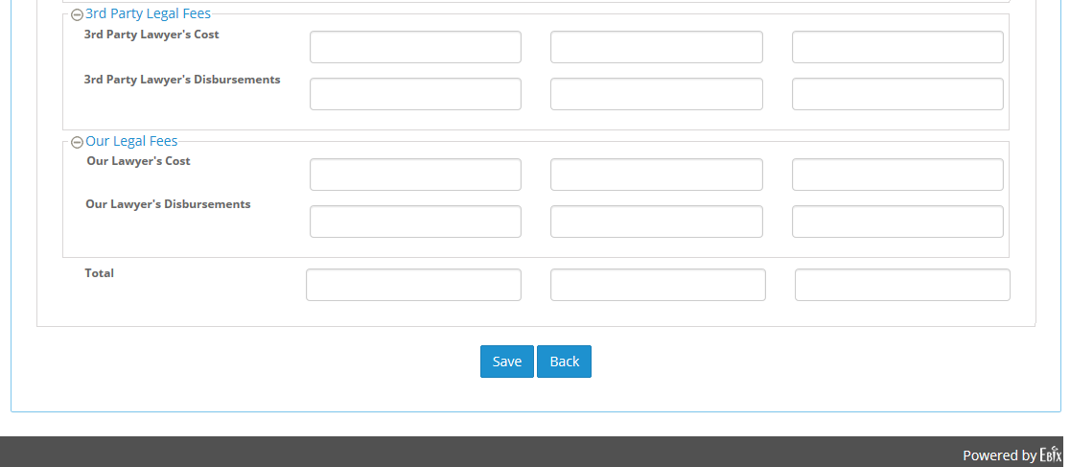
8.1.b) OD Claim Reserve Request sections ( Remaining Part )
e) 3rd Party legal Fees, f) Our Legal Fees

Slide 26
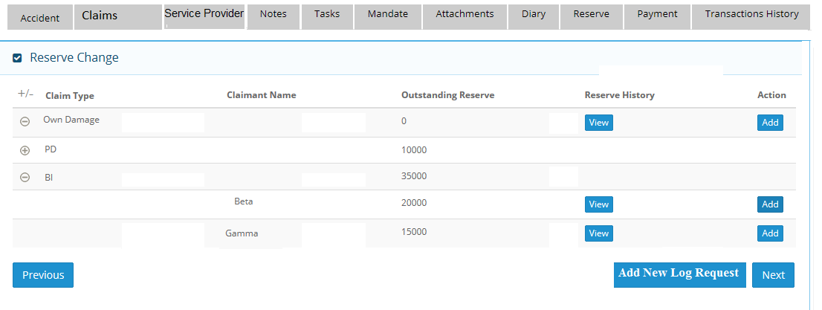
8.2) Bodily Injury(BI) Reserve Request
8.2.a) Header and Grid Section

Slide 27
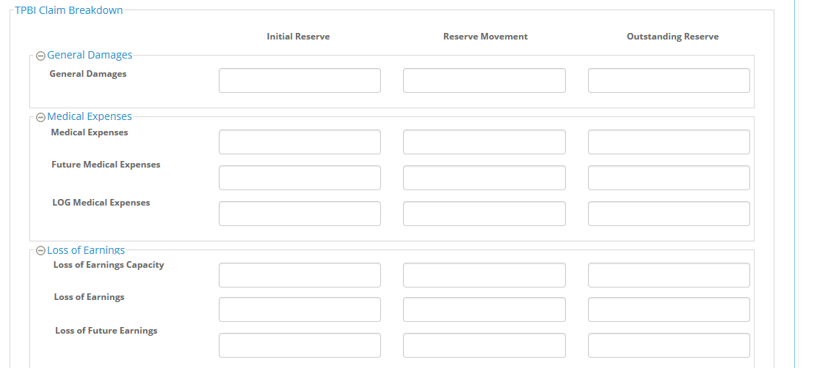
8.2.b) BI Claim Reserve Request sections (Partial Part)
a) General Damages, b) Medical Expenses, c) Loss of Earnings

Slide 28
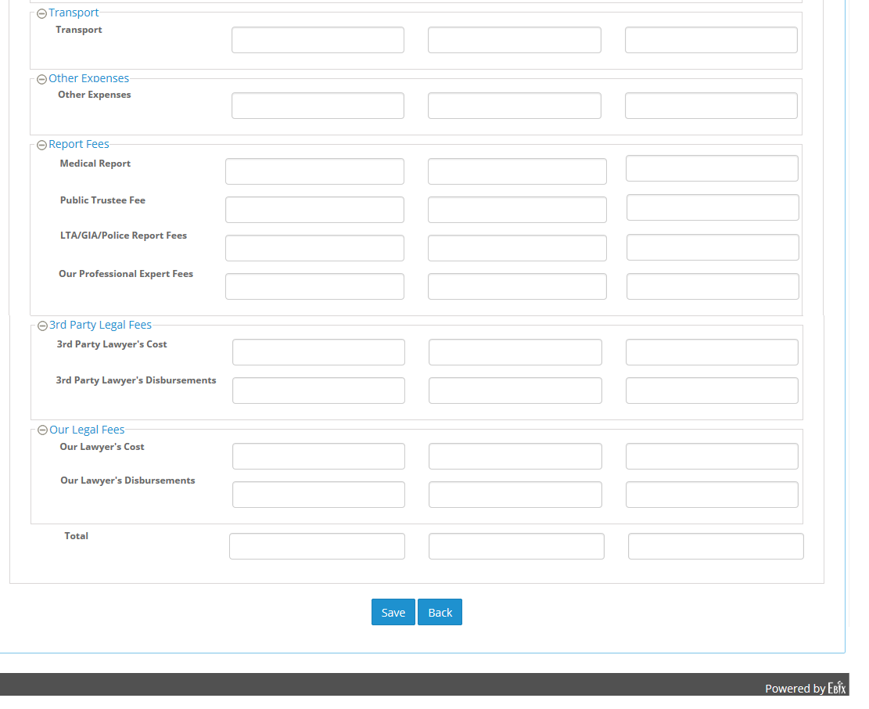
8.2.b) BI Claim Reserve Request sections (Remaining Part)
d) Transport, e) Other Expenses, f) Report Fees, g) 3rd Party Legal Fees, I) Our Legal Fees

Slide 29
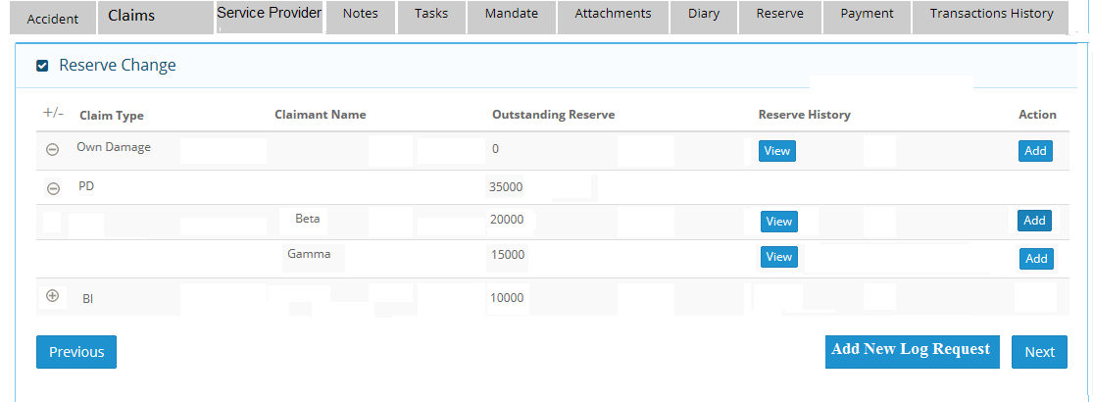
8.3) Property Damage(PD) Reserve Request
8.3.a) Header and Grid Section

Slide 30
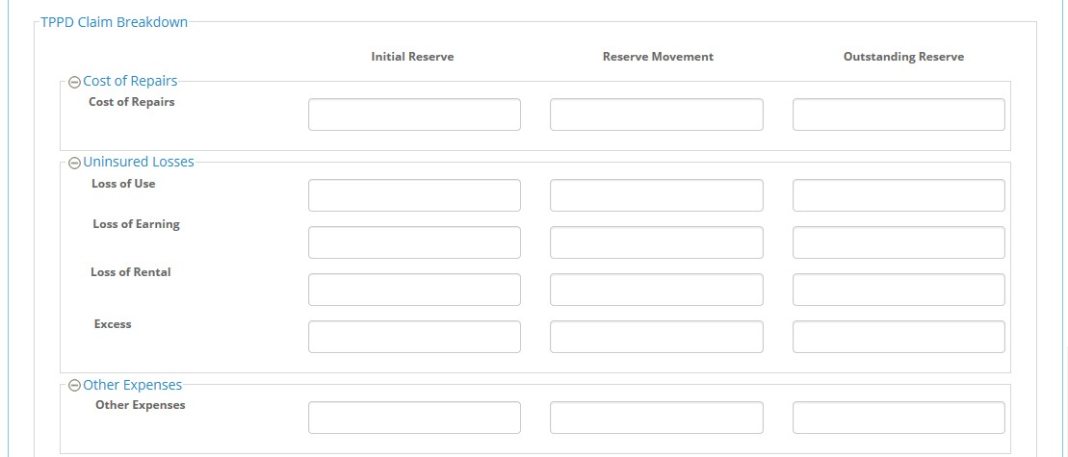
8.3.b) PD Claim Reserve Request sections (Partial Part)
a) Cost of Repairs, b) Uninsured Losses, c) Other Expenses

Slide 31
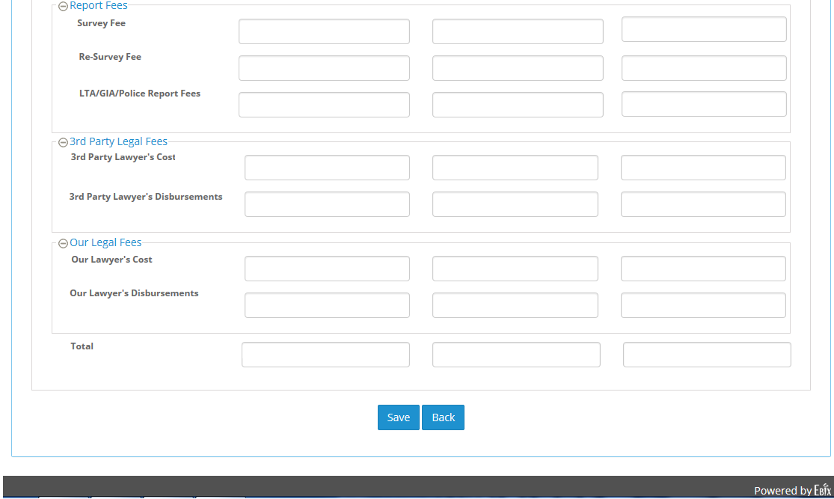
8.3.b) PD Claim Reserve Request sections (Remaining Part)
d) Report Fees, e) 3rd Party Legal Fees, f) Our Legal Fees

Slide 32
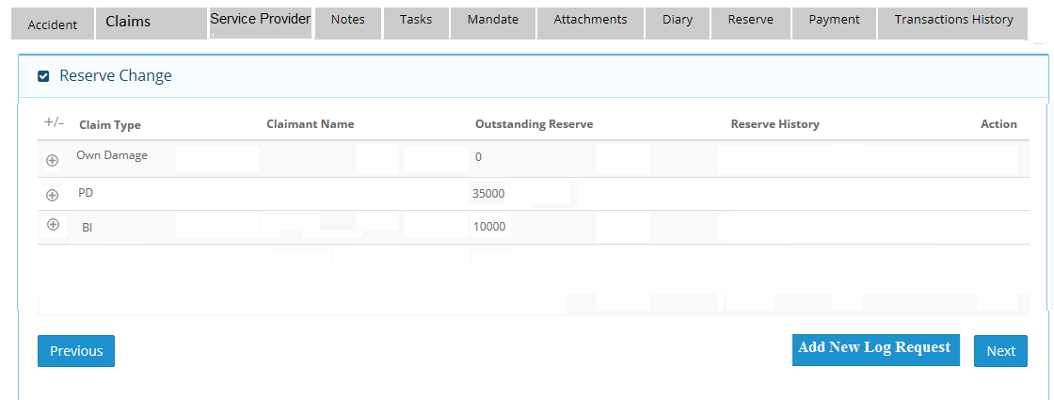
8.4) LOG Request
8.4.a) Header and Grid Section

Slide 33
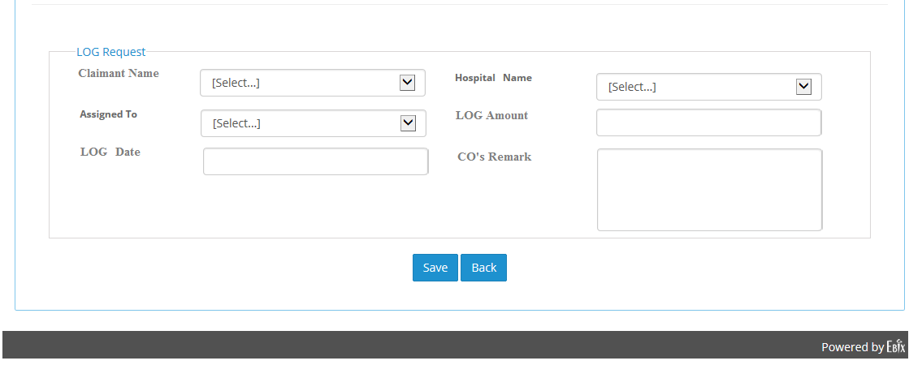
8.4.b) Add LOG Request section

